Slide 1
VISTA
Virtual Intelligent System for TNEA Admissions
Revolutionizing College Search with AI
Team Name:
SeekNSolvers
Members:
Rajeshkumar.S
Primya T
Kothai G
Nandhagopal S

Slide 2
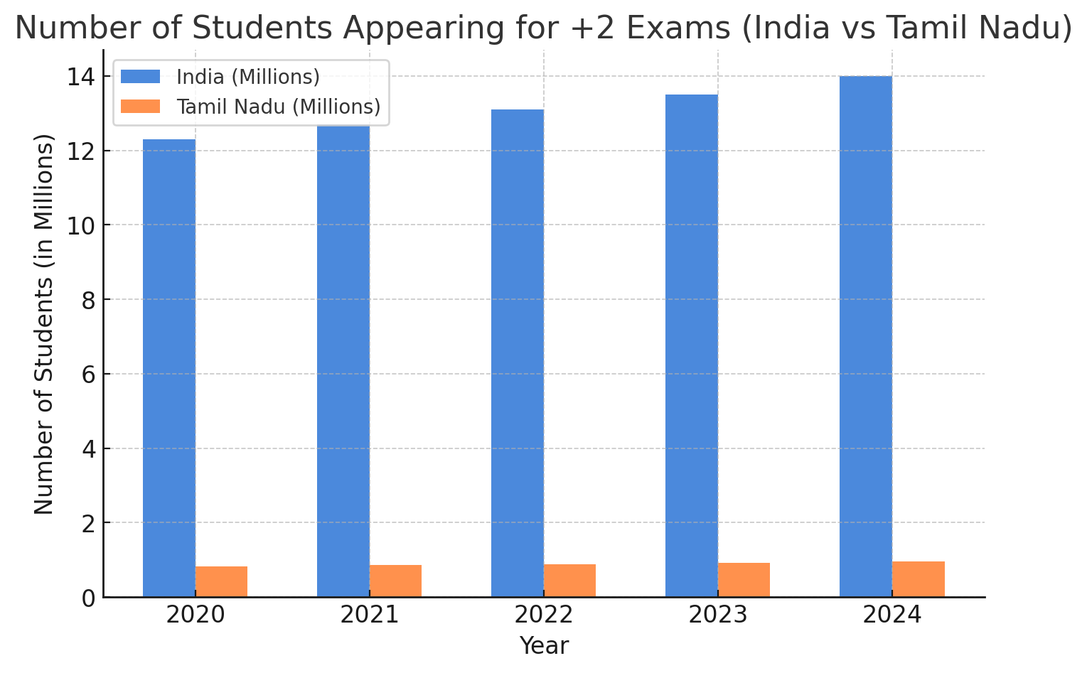
Problem Introduction with Statistics
Statistics Table: Students Appearing for +2 Exams (Last 5 Years)
Year | Students Appearing (India) | Tamil Nadu +2 Students
2020 | 12.3M | 8.3L
2021 | 12.7M | 8.6L
2022 | 13.1M | 8.9L
2023 | 13.5M | 9.2L
2024 | 14.0M | 9.5L

Slide 3
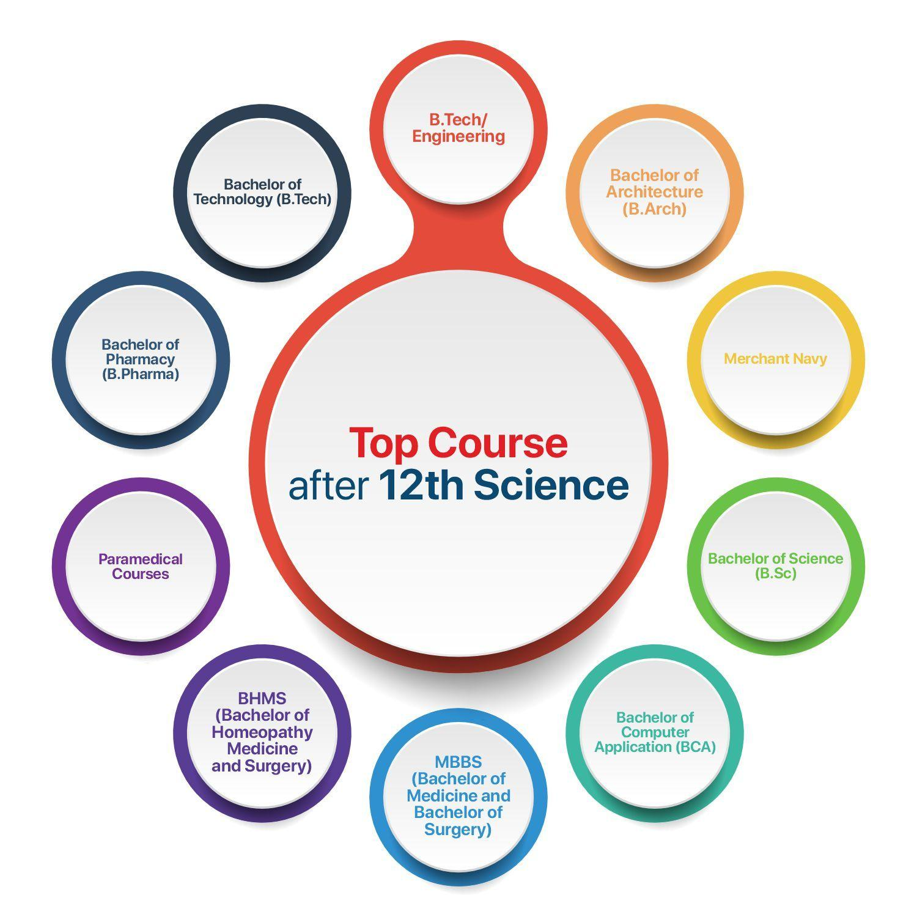
Higher Studies Enrollment Possibilities
NEET, JEE, GATE, UPSC, PSC, SSC
Cutoff-based admissions: ~50% of students need rank-based selection
Manual search = Time-consuming & complex
Why is this a Problem?
Students struggle to find the best-fit colleges quickly.
Manual process causes stress and confusion.
Huge number of applicants vs. limited seats in top institutions.

Slide 4

Proposed Solution: VISTA AI Chatbot
🔹 What is VISTA?
A Generative AI-powered chatbot that automates & simplifies the college search process based on:
✅ Cutoff marks ✅ Community & category ranking ✅ Historical admission data
🎯 How It Helps:
Faster decision-making (5 best college suggestions instantly)
No need for manual searching
Personalized recommendations

Slide 5
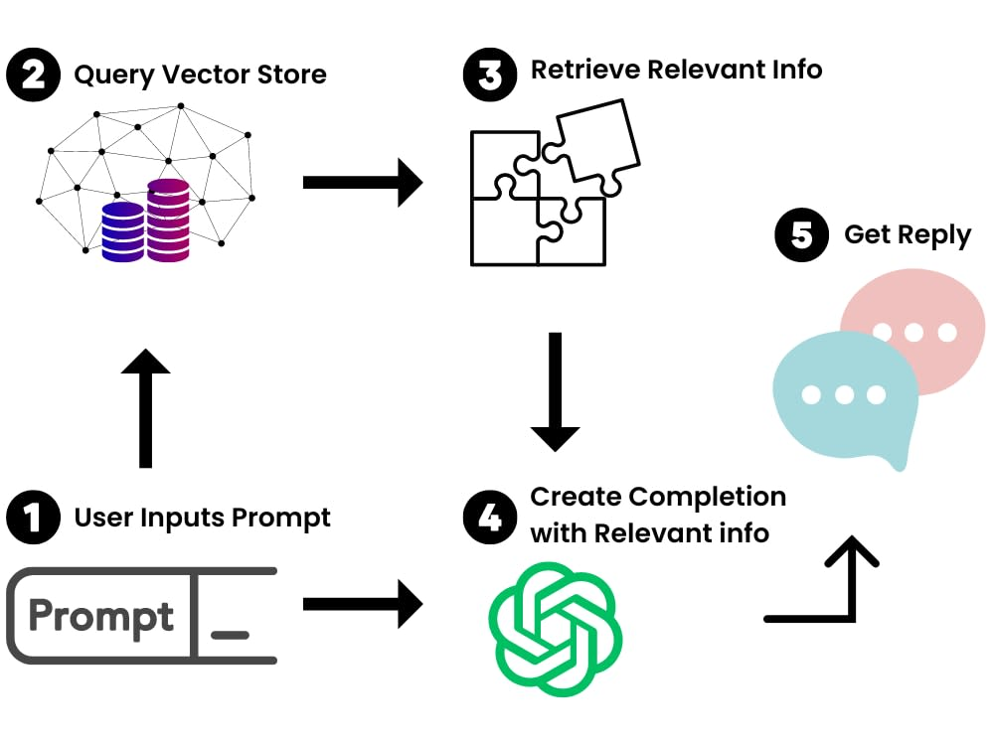
Methodology & Tech Stack
📌 Step-by-Step Process
1️⃣ Raw Data Collection (Previous admission data, cutoff trends) 2️⃣ Data Preprocessing (Convert into structured text using Python) 3️⃣ AI Model Development (LLama 3 via Together AI) 4️⃣ Inference Process (Pretrained .PKL file for fast predictions) 5️⃣ UI Interface (Streamlit for interactive user input) 6️⃣ Final Output: AI chatbot suggests Top 5 college choices

Slide 6
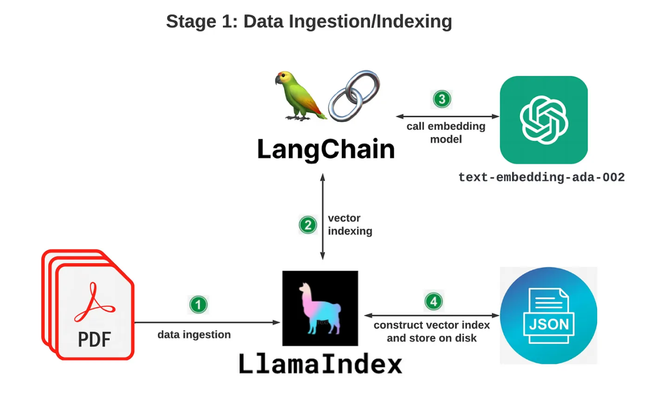
Methodology & Tech Stack (. . .)
Tech Stack Used
Python (Pandas, NumPy, Scikit-learn)
LLaMA 3 Model (Together AI API)
Streamlit (UI Development)
Pickle-based model storage (.PKL)
FastAPI for chatbot backend

Slide 7
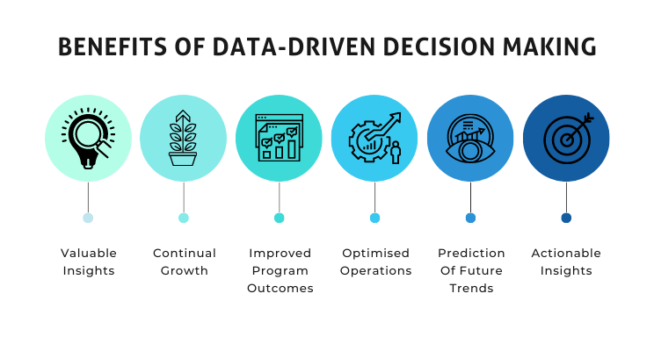
Projected Impact
✅ Reduces stress & confusion during admissions ✅ Ensures quick, data-driven college selection ✅ Eliminates bias & manual errors
📌 How VISTA Benefits Students
🚀 Scalability: Future Growth & Expansion
Can be expanded to competitive exams (JEE, NEET, GATE, TNPSC, UPSC, PSC, SSC)
Future goal: 10 million users in 5 years
Potential integration with state & central education portals

Slide 8
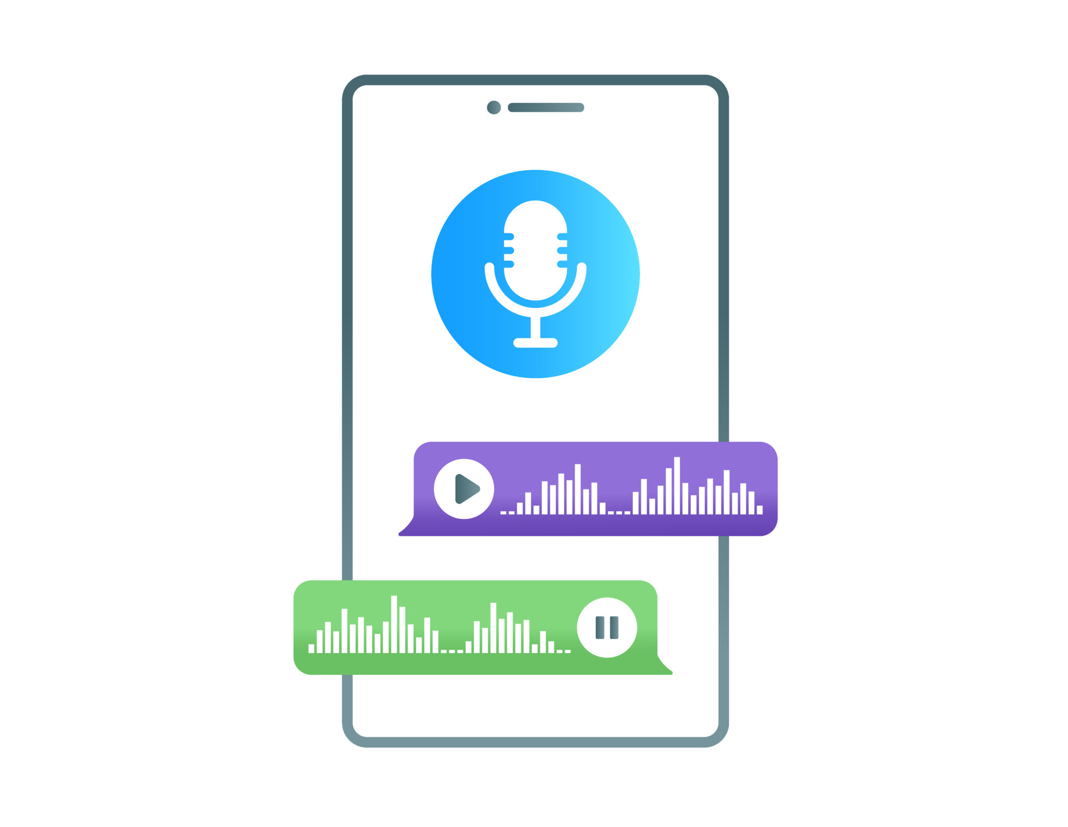
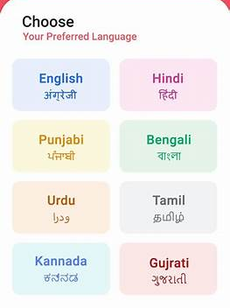
Future Enhancements
📌 How We Plan to Scale VISTA
Mobile App Development 📱
Voice-based AI Assistance 🔊
Multi-language support (Tamil, Hindi, English, etc.) 🌏
Integration with government & private college databases

Slide 9
APPENDIX
VISTA APPLICATION : GIT REPOSITORY
DEPLOYED VISTA APP : STEAMLIT SHARE FRAMEORK

Slide 10
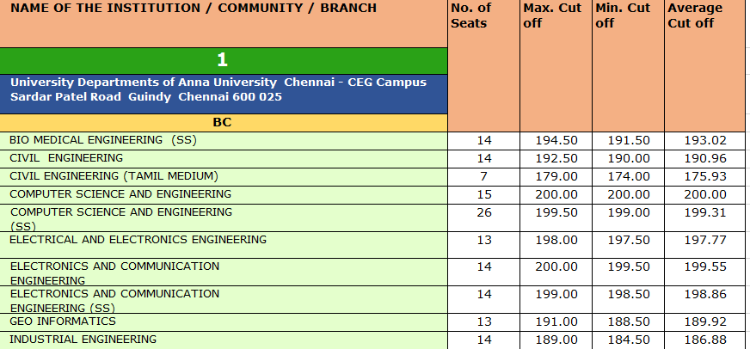
SCREEN SHOTS
Sample : Raw data in pdf document

Slide 11
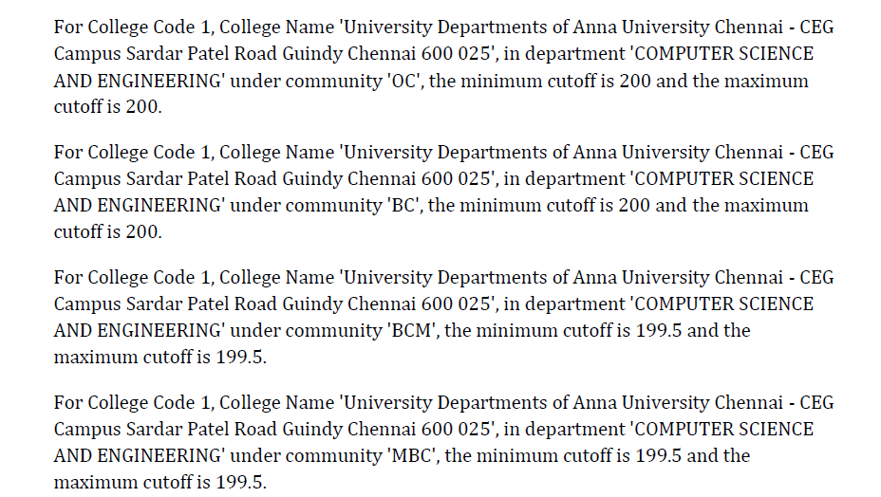
SCREEN SHOTS
Sample: Raw data in text form for chat model

Slide 12
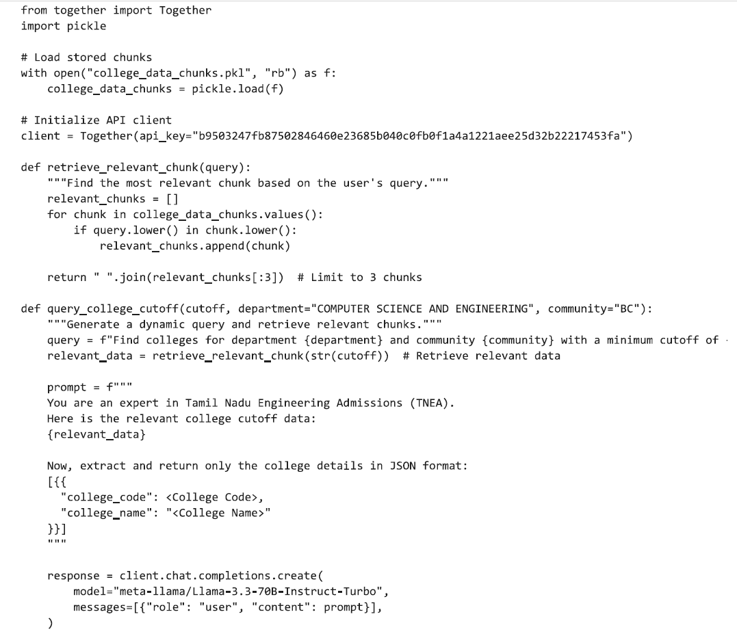
SCREEN SHOTS
Model Implementation with Extraction of Inference

Slide 13
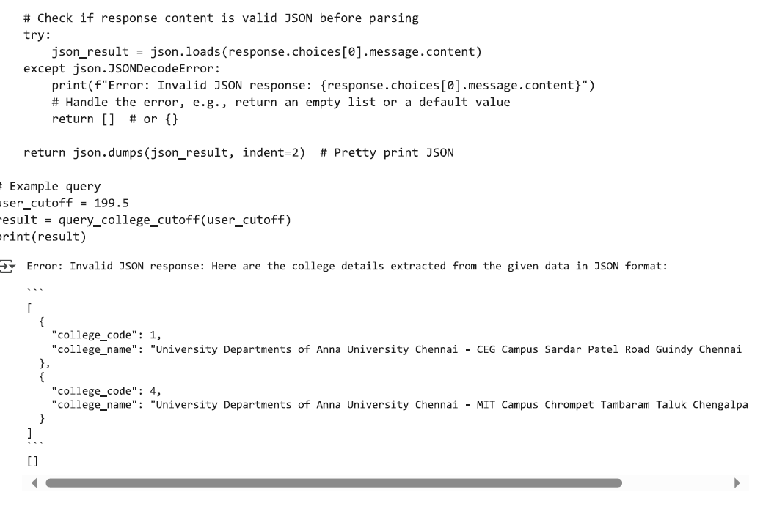
SCREEN SHOTS
Model outcome with Extraction of Json objects

Slide 14
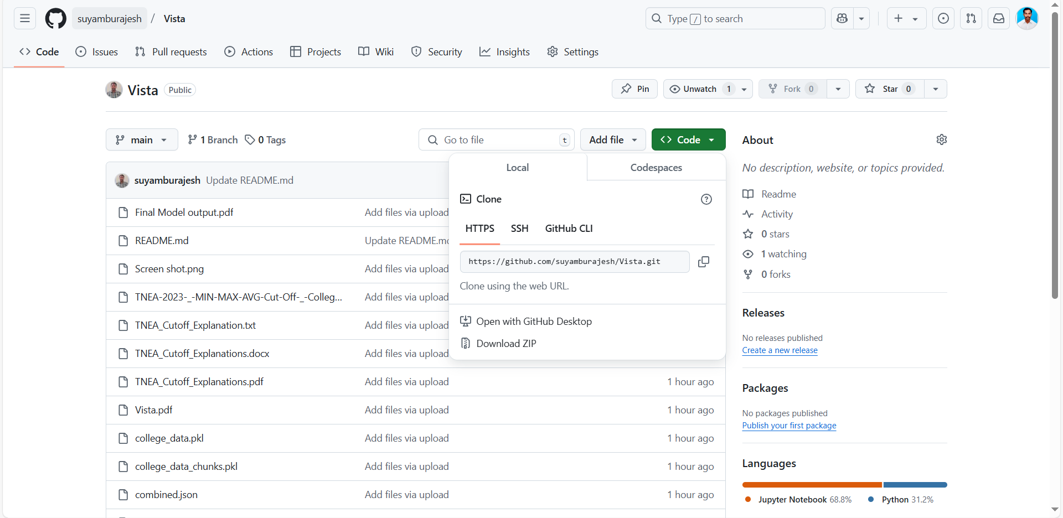
SCREEN SHOTS
Pushing resources to git-repo

Slide 15
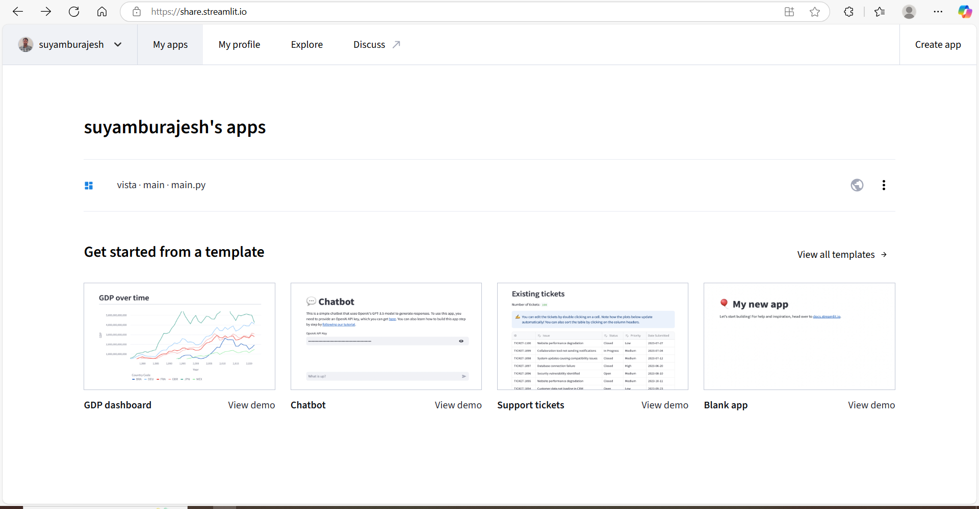
SCREEN SHOTS
Deploy the app with Streamlit share framework (Open source)

Slide 16
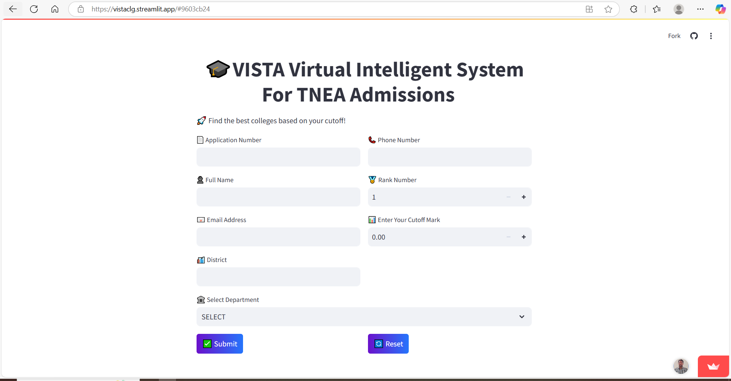
SCREEN SHOTS
Vista – Deployed Application

Slide 17
THANK YOU

